Slide 1
Introduction to Structured Programming
Character strings

Slide 2
Character strings
In programming, a string contains a sequence of characters, one after the other, for the purpose of storing textual information in memory (for example, a given name, a family name, an address, etc…)
In the context of this course, a string is in fact an array that can contain values of type char.

Slide 3
Character strings
Important terminology note:
In the context of this course, “string” will always mean “character string” – in other words, a char array.
It is very important not to confuse these character strings in C/C++ with C++ standard library strings, which we will not be studying in this course.

Slide 4
Character strings
The declaration of a character string is written as follows:
char str[const int MAX_SIZE + 1];
Declarations of character strings and of arrays follow the same rules, but strings require us to take another point into consideration as well. If we want to have a string with a maximum size of 9 characters, we must create a string of size [10] to be able to accommodate our 9 characters.

Slide 5
Character strings
Some examples of the declaration and assignment of character strings:
char str[10];
char str[10] = {'W','A','R','N','I','N','G','!','!'};
char str[] = {'W','A','R','N','I','N','G','!','!'};
char str[10] = "Warning!!";
char str[10] = "Hello world!"; // DANGER!!!
char str[] = "Hello world!"; // NO DANGER
char str[] = "Warning!!";
char str[10] = "HELLO"; // ?

Slide 6
Character strings
Some examples of using character strings
// not efficient at all, // and moreover not useful for display purposes
for (int i = 0; i < 10; i++)
{
cout << str[i];
}
cout << endl;
…
cout << str << endl; // much better!
…
str[0] = 'B';

Slide 7

Character strings
char str[10] = "HELLO";
For the string above, we declare a string of size 10, and we assign to it the value “HELLO”. What do you think will happen in memory?
A character string is an array, and when an array is partially initialized, the rest of its elements are initialized to the value 0. But what does the value 0 represent for a variable of type char?

Slide 8
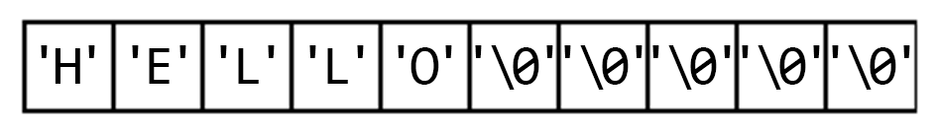
Character strings
So for a string of size 10 containing the characters HELLO, the array in memory will resemble the following:
This point is very important, for it reveals a crucial piece of information: we know exactly at what index the string terminates, for in a character string there must always be a space provided in advance for the NULL character (‘\0’) at the end of the string!

Slide 9
Character strings
We will be able to exploit this information when moving within character strings in order to manipulate the data contained in them

Slide 10
Character strings
When requesting a value by input, we have gotten in the habit of using cin to accomplish the task, but in the case of character strings, cin is not adapted for the task.
In a string, there are often spaces and tabulations (tabs). The cin object considers these characters as field separators, or field delimiters (characters prompting the termination of reading from a variable).

Slide 11
Character strings
For the following code, if we input Hello World…
#include <iostream>
using namespace std;
int main()
{
char str[20];
cout << "Enter a message: ";
cin >> str;
cout << str << endl;
system("pause");
return 0;
}

Slide 12
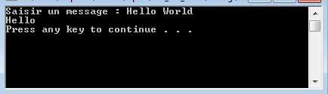
Character strings
…We obtain the following result:
Only Hello is displayed, since the space in the input message (between Hello and World) is treated as an end-of-field character (separator/delimiter). But what happens to the other characters that remain in the buffer?

Slide 13
Character strings
For the following code, if we input Hello World…
#include <iostream>
using namespace std;
int main()
{
char str[20];
cout << "Enter a message: ";
cin >> str;
cout << str << endl;
cout << "Enter another message: ";
cin >> str;
cout << str << endl;
system("pause");
return 0;
}

Slide 14
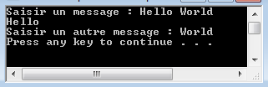
Character strings
…We obtain the following result:
The other characters remaining in the buffer are automatically sent to the next input, and cause a failure: the cin object is in semi-fail mode, for cin.peek() would return us a character different than ‘\n’ (character 32 in fact, which is the Space character).

Slide 15
Character strings
But how can we input a value in the form of a character string when the input contains spaces or tabs?
By replacing the use of cin >> with the use of the cin.getline() function. This function takes a pointer to a char as its first parameter, and takes the maximum size of the string as its second parameter:

Slide 16
Character strings
#include <iostream>
using namespace std;
int main()
{
char str[20];
cout << "Enter a message: ";
cin.getline(str, 20);
cout << str << endl;
cout << "Enter another message: ";
cin.getline(str, 20);
cout << str << endl;
system("pause");
return 0;
}

Slide 17
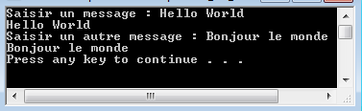
Character strings
Now we obtain the following result:

Slide 18
Character strings
But what happens when the user inputs too many characters given the size of the array?

Slide 19
Character strings
#include <iostream>
using namespace std;
int main()
{
char str[20];
cout << "Enter a message: ";
cin.getline(str, 20);
cout << str << endl;
system("pause");
return 0;
}

Slide 20

Character strings
On the face of it, the only problem that has occurred is that only one part of the string is copied into the array.
But in the background, something else has happened!

Slide 21
Character strings
#include <iostream>
using namespace std;
int main()
{
char str[20];
cout << "Enter a message: ";
cin.getline(str, 20);
cout << str << endl;
cout << "Enter another message: ";
cin.getline(str, 20);
cout << str << endl;
system("pause");
return 0;
}

Slide 22

Character strings
The cin object has fallen into fail mode…
Thus we need to apply an input validation to prevent this kind of problem.

Slide 23
Character strings
#include <iostream>
using namespace std;
int main()
{
char str[20];
cout << "Enter a message (max 20 characters): " << endl;
cin.getline(str, 20);
while (cin.fail())
{
cin.clear();
cin.ignore(512, '\n');
cout << "Enter a message (max 20 characters): " << endl;
cin.getline(str, 20);
}
cout << str << endl;
system("pause");
return 0;
}

Slide 24
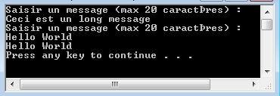
Character strings
We can see that the first message we give as input causes the code to enter into the while loop and to ask again for input.
If we then enter a shorter message that doesn’t exceed the limit of 20 characters, our message will be displayed properly:

Slide 25
Character strings
Do you recall, from when we discussed validating values input with cin, how we placed an extra cin.ignore(512, ‘\n’); following the end of the input and validation?
int val;
cin >> val;
while (cin.fail() || cin.peek() != '\n')
{
cin.clear();
cin.ignore(512, '\n');
cin >> val;
}
cin.ignore(512, '\n');

Slide 26
Character strings
Adding this command was specifically in anticipation of our future use of cin.getline().
Let’s take the following code:

Slide 27
Character strings
#include <iostream>
using namespace std;
int main()
{
char str[20];
cout << "Enter a message (max 20 characters): " << endl;
cin.getline(str, 20);
cout << str << endl;
int val;
cout << "Enter a number: ";
cin >> val;
cout << val << endl;
system("pause");
return 0;
}

Slide 28
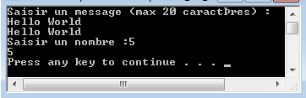
Character strings
All seems to be going well:
But if we invert the order of execution of cin and cin.getline():

Slide 29
Character strings
#include <iostream>
using namespace std;
int main()
{
int val;
cout << "Enter a number: ";
cin >> val;
cout << val << endl;
char str[20];
cout << "Enter a message (max 20 characters): " << endl;
cin.getline(str, 20);
cout << str << endl;
system("pause");
return 0;
}

Slide 30
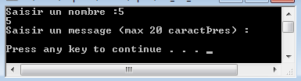
Character strings
This behaviour is not correct. The program does not give us the time to enter a message to fill the string with.
The reason is that, when we use the cin object to input numerical values, after the input, there remains in the buffer the character ‘\n’ (which is in fact a line return).

Slide 31
Character strings
Upon subsequently calling cin.getline(), this remaining character is automatically interpreted by the function, and applies a line return without giving the user the opportunity to input anything.
It is for this reason that we need to add the call to cin.ignore() after using a cin: it is in order to ensure that nothing remains left over in the buffer after using the cin.

Slide 32
Character strings
#include <iostream>
using namespace std;
int main()
{
int val;
cout << "Enter a number: ";
cin >> val;
cout << val << endl;
cin.ignore(512, '\n');
char str[20];
cout << "Enter a message (max 20 characters): " << endl;
cin.getline(str, 20);
cout << str << endl;
system("pause");
return 0;
}

Slide 33
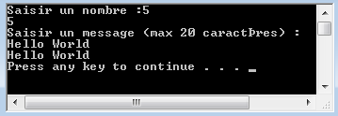
Character strings

